Slide 1
Digital Surveyor
Title: How would you approach the creation of Digital Surveyor tool ?

Slide 2









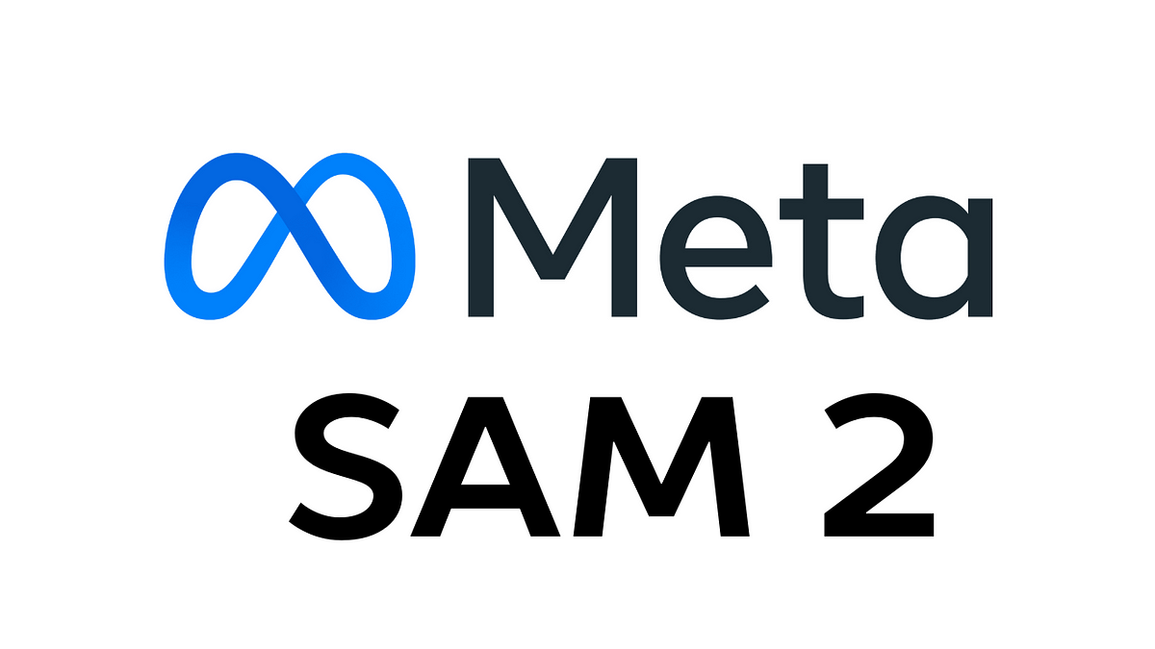



Hi I’m Zeeshan Afzal
Machine Learning Engineer, ASR, Computer Vision, and LLM Development Expert
Education: BS Computer Science 2018
Msc Artificial Intelligence 2025
Experience: 7+ Years in AI/ML & Full Stack App Development
Tech Stack
Frontend:
Backend:
ML:

Slide 3




Core services provided
Project & Development Management
Building Surveying
Advisory & consulting
Property and Facilities Management
About
CORELAIN
Founded: 2022
Founder & CEO
Director
Director
Ian Chadwick
Adrian Patel
James Pemberton

Slide 4
Core services provided
Valuations
Party Wall
Thermography
Drone Services
About
CORELAIN
Regulated by RICS

Slide 5
Need of Surveyor Tool ?
Traditional property surveys are slow and inconsistent due to human variability.
AI model can be trained to analyze images and videos quickly and reliably.
A Digital AI Surveyor ensures faster, consistent, and scalable surveying.

Slide 6
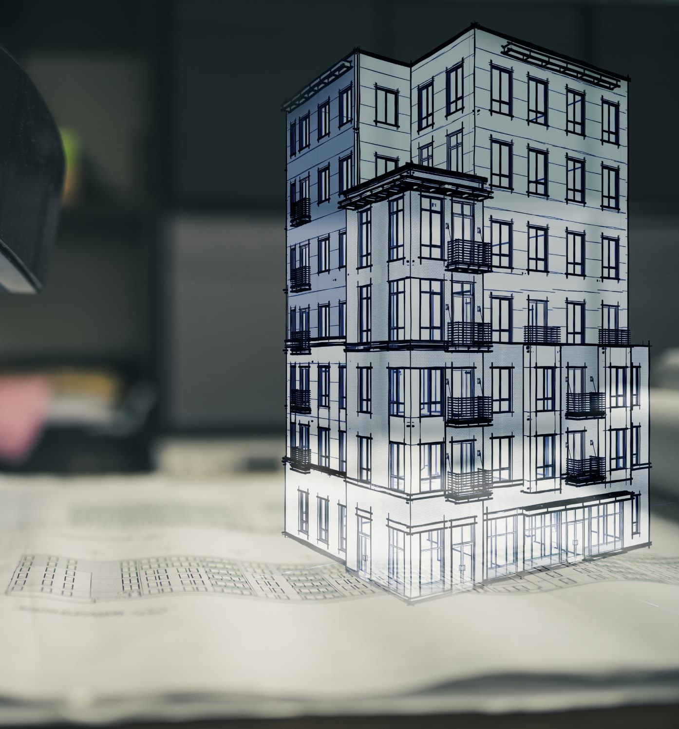
Approaches for Property Surveys
CNN-Based Defect Detection
Convolutional neural networks analyze images for property defects and classify them with high accuracy, but with limited context understanding.
If there is no issues in image it will still give us some random value specially for classification
e.g for a binary classifier of thermal or rgb image if you provide a greyscale it will still give either thermal or rgb
Vision-Language Model Integration
Combining images and descriptive text, vision-language models detect and classify defects while providing rich contextual understanding.
Since its one-shot we can very easily specify unknown class even for images other then grey scale like fluoresce image or an x-ray.
Notes:
Image source: Microsoft 365 content library There are two main approaches for creating a digital AI property surveyor tool to analyze images: (1) Using CNN-based models for defect detection and classification, and (2) Applying vision-language models for image understanding. | Approach | Data Input | Detection | Classification | Context Understanding | |---|---|---|---|---| | CNN Pipeline | Images | High | High | Limited | | Vision-Language Model | Images + Text | High | High | Rich |

Slide 7
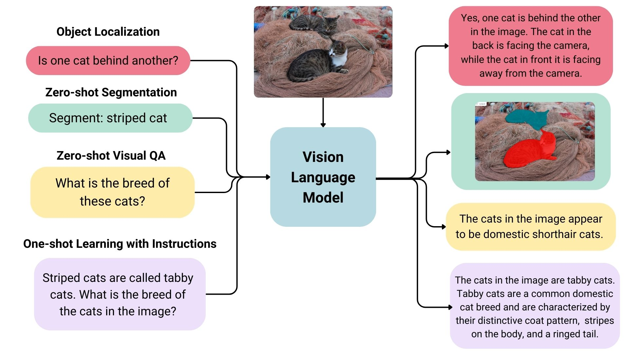
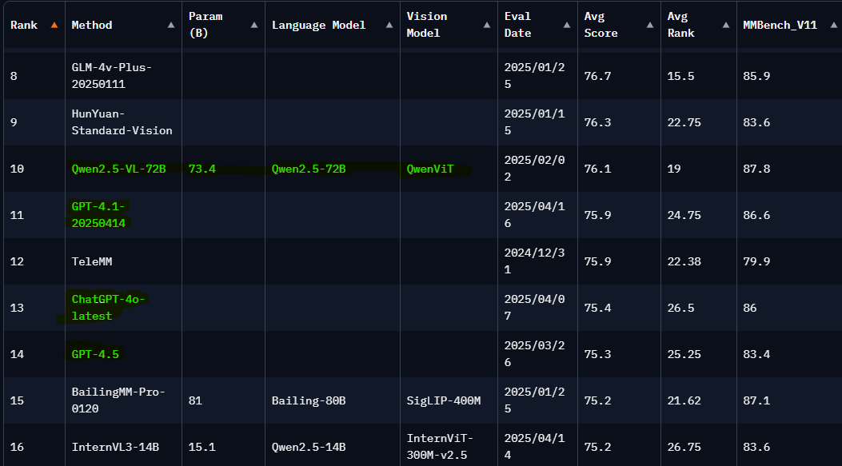
Vision Language Models
Understating VLMs
Leaderboard
Refernce: https://huggingface.co/blog/vlms

Slide 8
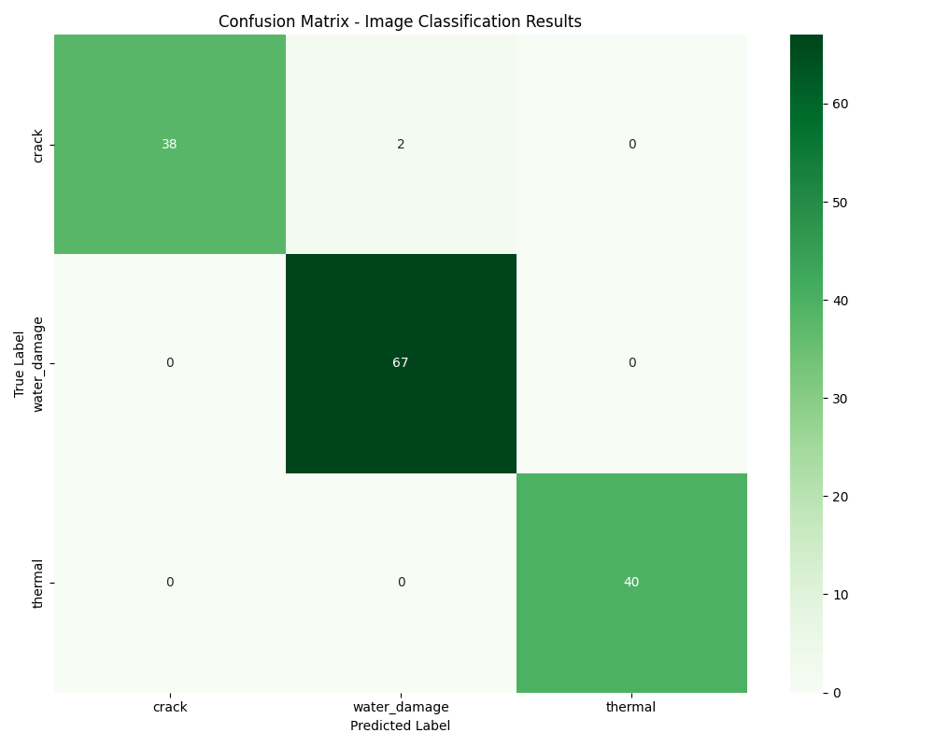
QWEN2.5 Confusion Matrix
Total images processed: 147
Overall accuracy: 98.64%
Per-category accuracy:
Crack:
95.00% ███████████████████░ (38/40)
Water Damage:
100.00% ████████████████████ (67/67)
Thermal:
100.00% ████████████████████ (40/40)

Slide 9
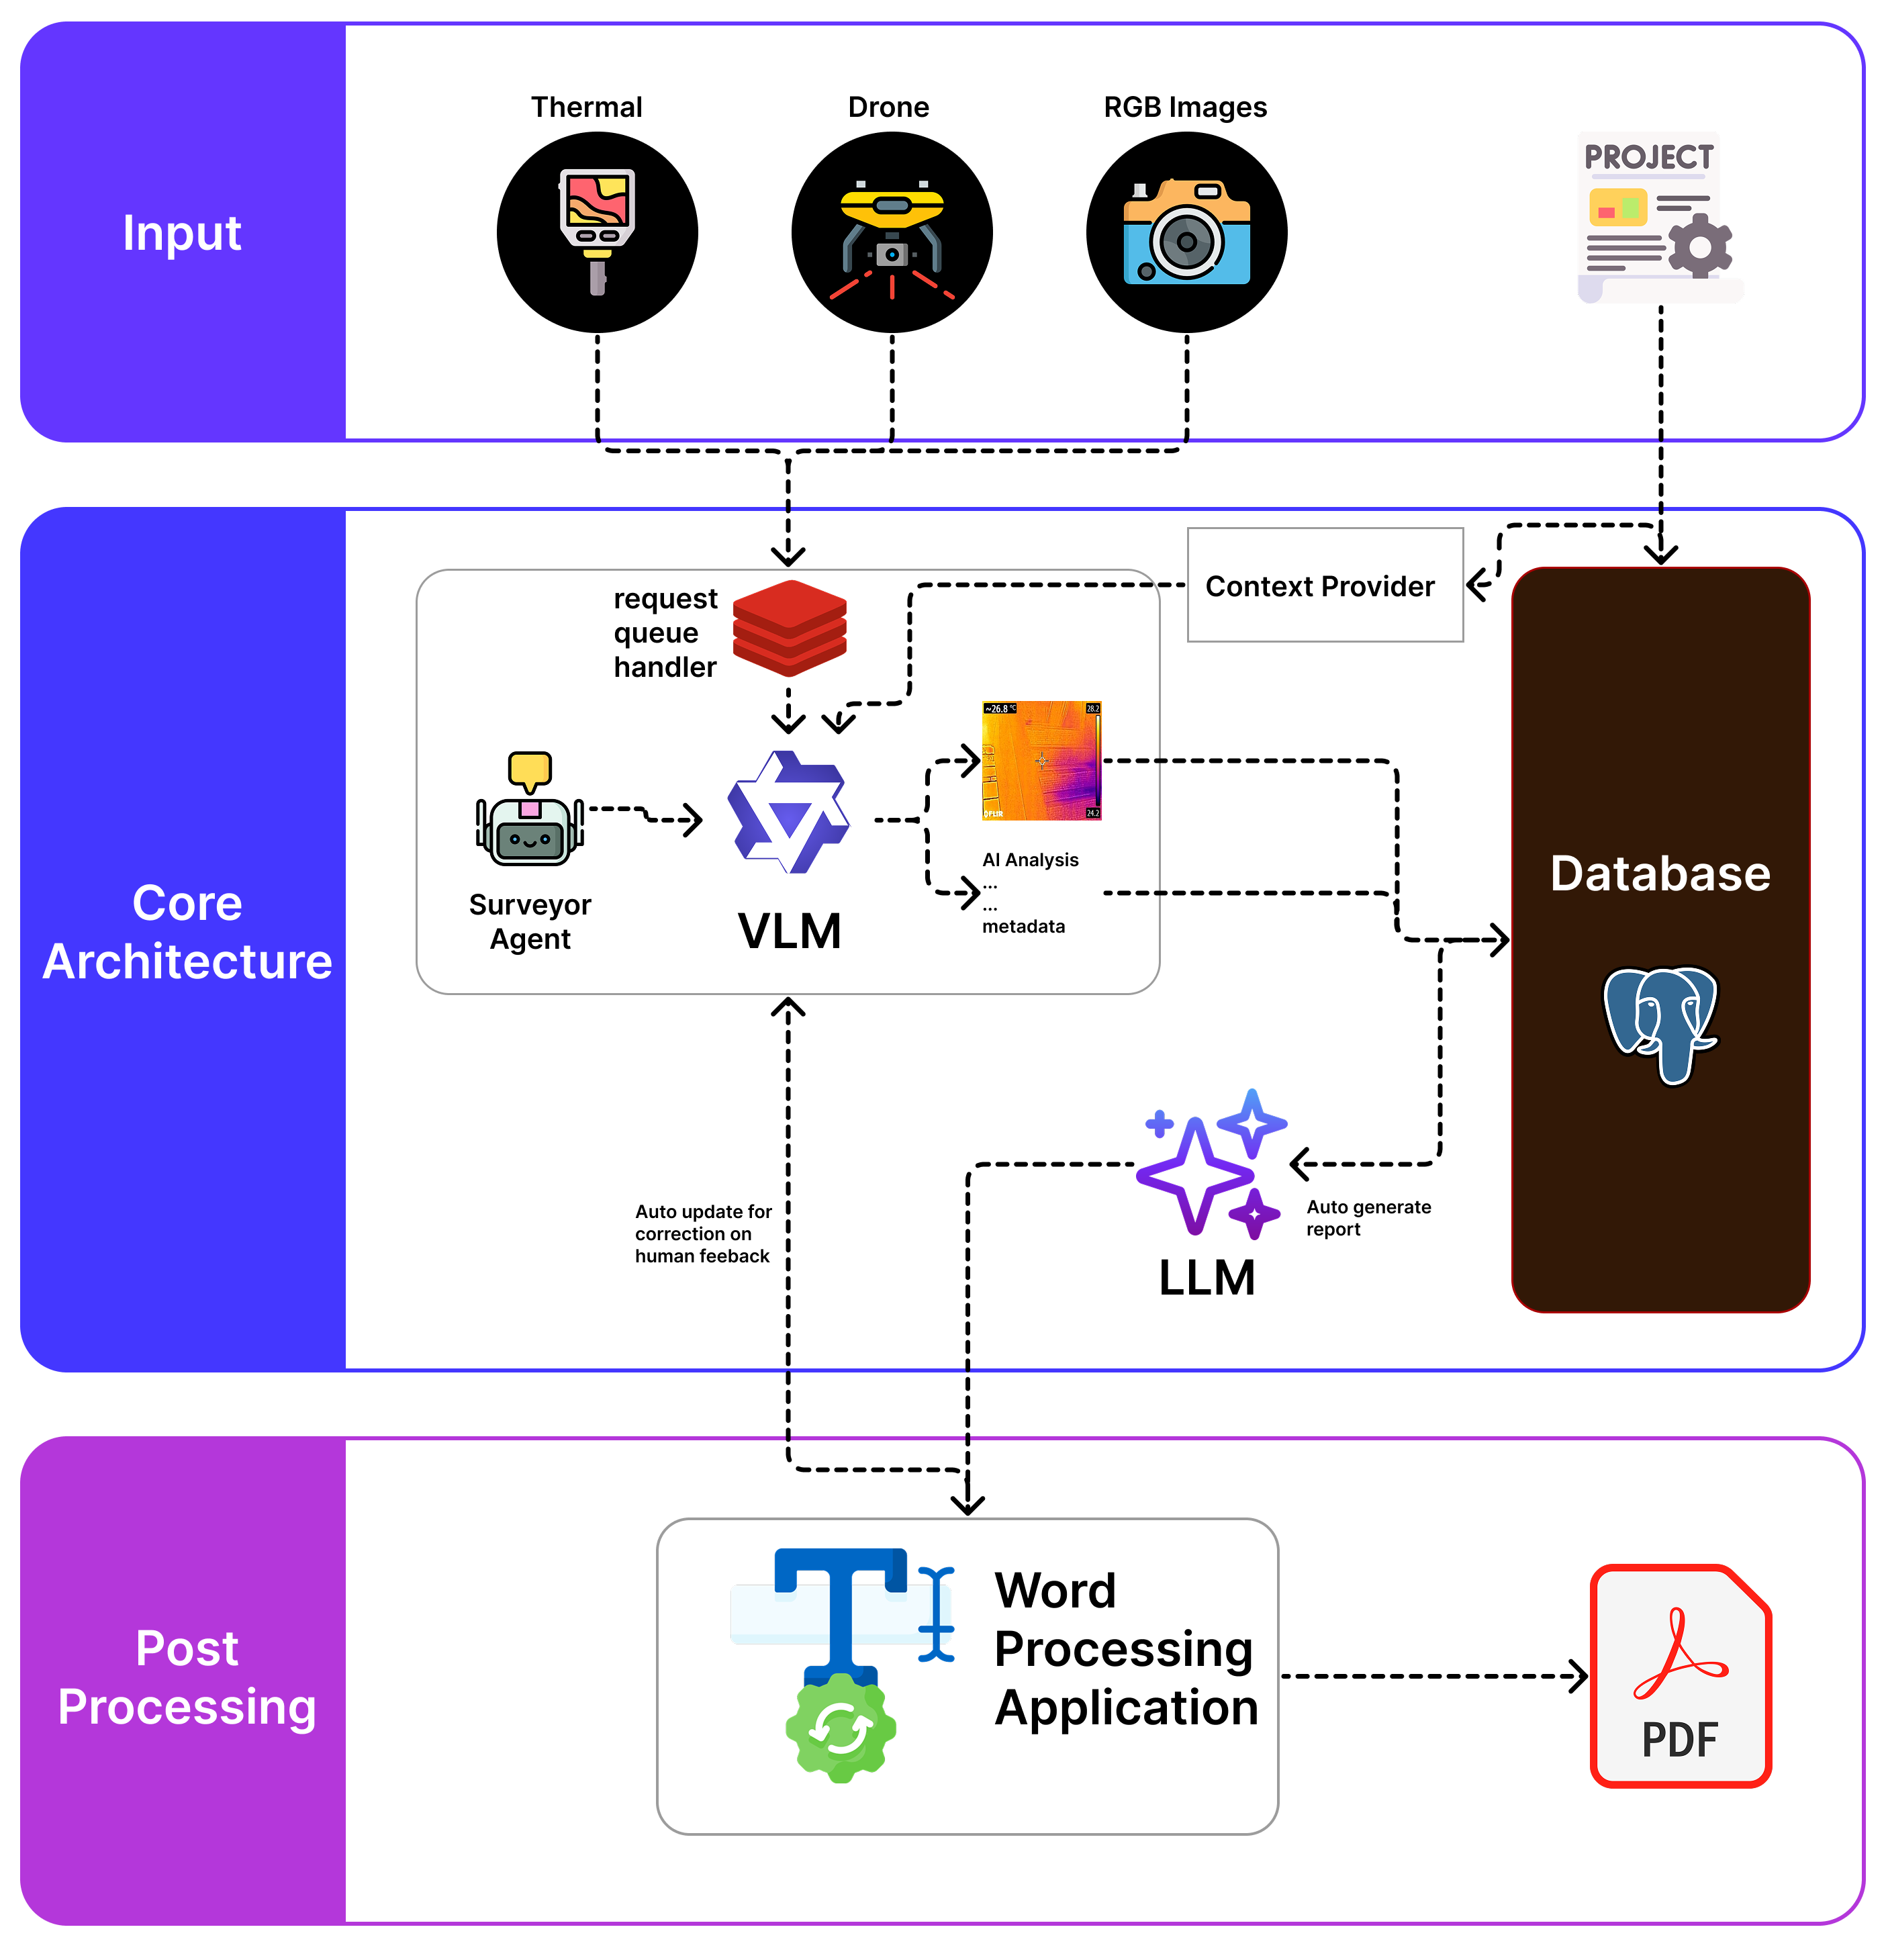

Proposed Architecture
Advantages:
It will let the language model understand the bigger picture. (Condition of whole construction)
Agentic structure will let integration in with famous word processing tool like MS Word
Central database will let creation of a RAG bot for internal use cases.

Slide 10
Thank You

